Slide 1




ANIMAL DISEASE REPORTING SYSTEM
A Multi-Stage Artificial
Intelligence Framework
for Proactive Livestock
Health Monitoring and
Outbreak Surveillance
PROJECT ID
[R26-SE-013]
ADRS / RESEARCH DEFENSE
01 / 12

Slide 2


ADRS / RESEARCH PRESENTATION
02 / 12

Slide 3




01 / PROBLEM
Problem, stakeholders & measurable pain
01
02
03
04
FARMERS / SMALLHOLDERS
VETS / FIELD OFFICERS
DAPH / DISTRICT TEAMS
NATIONAL PLANNERS
Access & triage
Gating & comorbidity
Spatial latency
Sparse macro data
1.65M families face reactive
reporting; LSD averages 32% milk
loss and Rs. 21,212 loss per
animal.
THI > 72 can mimic disease;
subclinical mastitis prevalence
reaches 74.5–100%.
Retrospective reports miss dynamic
clusters and spread vectors before
action is coordinated.
Zero-heavy DAPH grids contain
only 12.75% FMD and 7.67% LSD
positive district-months.
Problem statement: no affordable, shared evidence chain currently moves from farmer signal to clinical action,
mapped trajectory, and district response.
ADRS / RESEARCH PRESENTATION
03 / 12

Slide 4

02 / GAP
From isolated tools to one evidence chain
Existing approaches
FRAGMENTED
ADRS response
FOUR TIERS
Industrial PLF and 3D sensing
2D mobile BCS + GPS-linked THI late fusion
Closed-world single-label vision
?
→
OOD gate + multi-label Swin diagnosis
Static lesion or disease maps
BSS, prognosis, and explainable clinical outputs
Retrospective administrative reports
ST-DBSCAN + EVF + Ridge trajectories
Black-box, zero-heavy forecasting
Calibrated nowcasting + conformal uncertainty
The gap is operational: evidence must move from farmer-triggered triage to
clinical severity, mapped trajectories, and concurrent district-level risk.
ADRS / RESEARCH PRESENTATION
04 / 12

Slide 5
03 / RESEARCH LOGIC
Four objectives, four operational tiers
TIER 1
TIER 2
TIER 3
TIER 4
Wellness triage
Clinical core
Spatial trajectories
Risk nowcasting
Dual-trigger logs, 2D BCS, GPS
THI, and late-fusion classification.
Reject invalid inputs; diagnose
comorbidities; quantify BSS and
prognosis.
Cluster cases, model
environmental vectors, and project
centroid movement.
Estimate calibrated district-month
risk with uncertainty and XAI.
→
ONE FRAMEWORK, DISTINCT EVIDENCE STATUS
4 STRUCTURED CONTRIBUTIONS
ADRS / RESEARCH PRESENTATION
05 / 12

Slide 6

04 / PROPOSED FRAMEWORK
The ADRS four-tier operating model
TIER 1 / FARM
TIER 2 / CLINICAL
Wellness triage
Diagnosis & prognosis
Milk + weight dual trigger · 7-day behavior · YOLOv8 / CNN BCS · GPS
THI late fusion
YOLOv8 / AE gate · Swin multi-label · Mask R-CNN / BSS · MLP
recoverability
TIER 3 / SPATIAL
TIER 4 / MACRO
Trajectory intelligence
Concurrent risk nowcasting
FastAPI / MongoDB· ST-DBSCAN · EVF · Ridge Day+7 / +14 / +21
25 districts · climate/teleconnection grids · calibrated risk · conformal
sets · linear log-odds XAI
FARM SIGNAL → CLINICAL EVIDENCE → SPATIAL TRAJECTORY → DISTRICT-MONTH RISK
FOUR SYNCHRONIZED TIERS
FMD + LSD
DECISION SUPPORT, NOT END-TO-END VALIDATION
ADRS / END-TO-END EVIDENCE FLOW
06 / 12

Slide 7
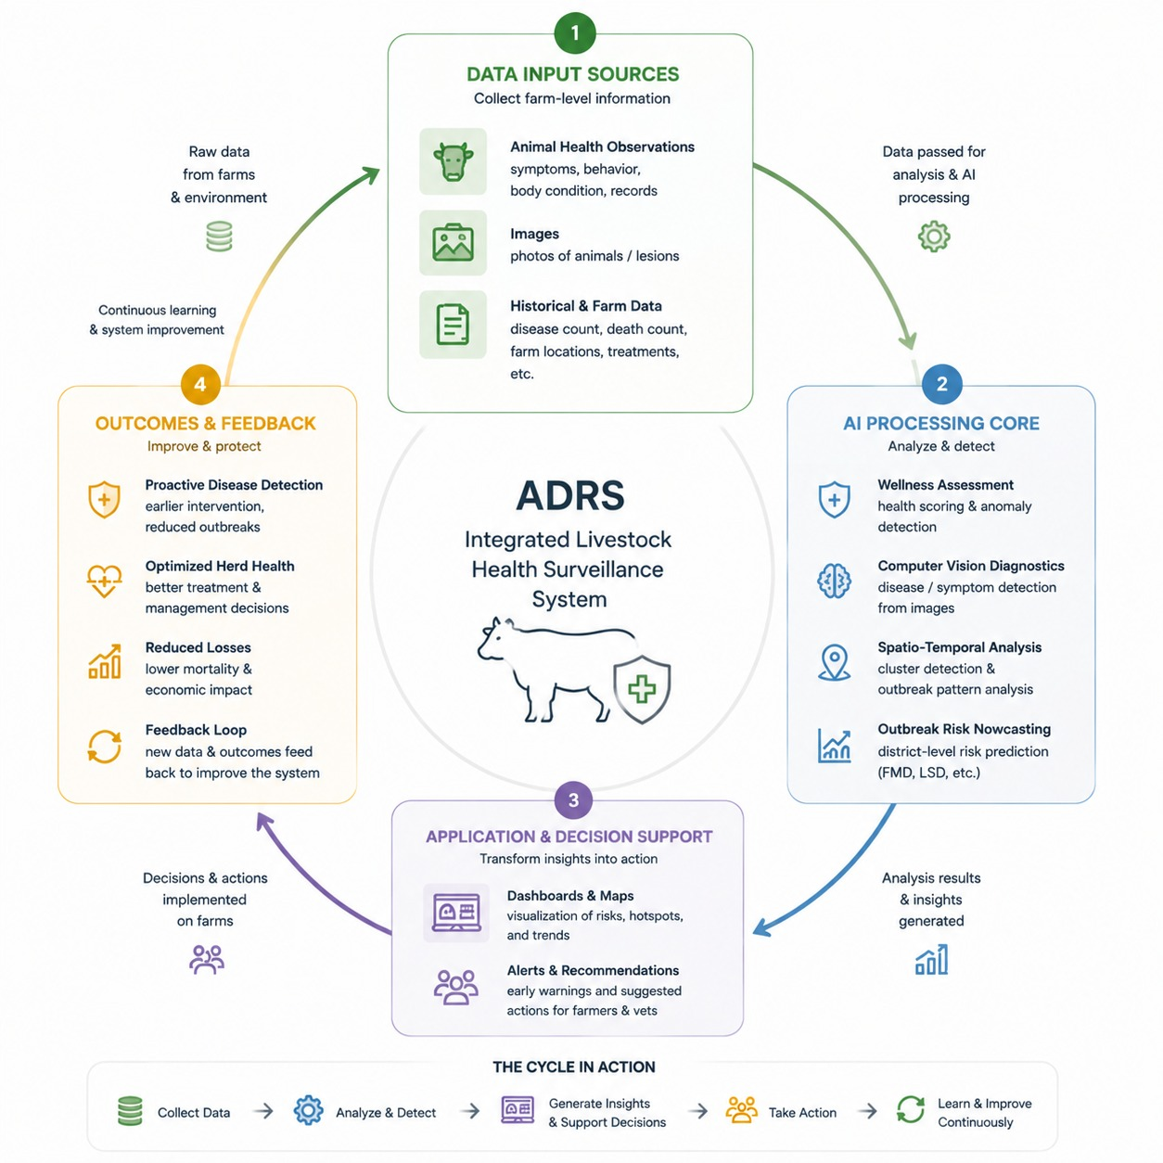
05 / INTEGRATION
System Architecture
&
Integration
ADRS PLATFORM
API COMMUNICATION
ADRS / RESEARCH PRESENTATION
07 / 12

Slide 8
06 / EVALUATION
Evaluation evidence & non-functional requirements
EVIDENCE SOURCES
VALIDATION PROTOCOLS
Local signals + national archives
Split by task and time
Combines local Sri Lankan field data with national outbreak records and trusted climate sources to build reliable disease-risk evidence.
Each model is evaluated using a validation method suited to its task, while chronological splits prevent future data from leaking into past predictions.
FMD: 2,400 DISTRICT-MONTHS · LSD: 1,500
AUDIT THE SPLIT BEFORE TRUSTING THE SCORE
NFR 01 / PERFORMANCE
NFR 02 / ROBUSTNESS
NFR 03 / AUDITABILITY
NFR 04 / TRUST
Spatial processing latency <3 seconds
OOD rejection prevents unsuitable inputs
downstream
862 / 862 automated tests passed
Calibration, conformal uncertainty,
provenance, and XAI
ADRS / RESEARCH PRESENTATION
08 / 12

Slide 9
07 / EVIDENCE
Audited results & decision threshold
COMPONENT EVIDENCE
Multi-tier reconciliation
Disease Classification
Performance evidence from all four ADRS tiers was reviewed together to verify accuracy, robustness, spatial speed, and software reliability.
90.11% Accuracy gained using vision transformer model
Cattle Detection
AUDIT STATUS
84.6% Accuracy gained by YOLO model
All 862 automated backend and frontend tests passed, confirming the integrity of the integrated software pipeline.
These accuracies highlights the strength of deep learning in diverse computer vision tasks
ADRS / RESEARCH PRESENTATION
09 / 12

Slide 10
08 / READINESS
Integration status & completion gates
COMPLETE / T1 + T2
01
COMPLETE / T3
02
Farm → clinical path
Case → trajectory service
Evaluation results from all four tiers were reviewed together to confirm model performance, spatial speed, robustness, and reliability.
Evaluation results from all four tiers were reviewed together to confirm model performance, spatial speed, robustness, and reliability.
RETROSPECTIVE / T4
03
GATED / DEPLOYMENT
04
Grid → calibrated risk
Evidence → field release
Lowering the FMD decision threshold from 0.50 to 0.40 improved outbreak recall from 47.4% to 67.9%, while accepting more false-positive alerts.
The integrated software pipeline passed 862 of 862 automated tests, covering both backend and frontend verification.
Status: demonstrator-ready as an integrated evidence chain; not yet cleared for
READINESS / GATES
production or end-to-end clinical deployment.
ADRS / RESEARCH PRESENTATION
10 / 12

Slide 11
09 / COMMERCIALIZATION
Commercialization & demo roadmap
Beachhead & value
Demo → pilot → scale
PROPOSED
ROADMAP
Primary users: veterinary services, field officers, and district surveillance
teams.
01 / Research demo: replay retrospective FMD/LSD grids; show triage,
maps, calibrated risk, and audit evidence.
Packaging: mobile farmer / field capture → veterinarian console →
district dashboard and API.
02 / Authorized pilot: connect DAPH transmission with provenance and
leakage-safe temporal processing.
Value: prioritize visits, expose uncertainty, map response zones, and
reduce manual reporting friction.
03 / Prospective validation: test thresholds, latency, usability, and end-to-end
handoffs with field teams.
Claim boundary: decision support only until prospective and end-to-end
validation.
04 / Scale: expand districts, procurement packaging, monitoring, and
governance after evidence gates.
The commercial path is gated by the same scientific disclosures: LSD 2024 fold collapse, strict-independent weakness,
same-month nowcasting, DAPH authorization, and leakage-safe validation remain visible.
SEPARATE CLAIMS FROM
PLANS
ADRS / RESEARCH PRESENTATION
11 / 12

Slide 12

10 / CONCLUSION
Four tiers make the signal actionable.
ADRS connects farm wellness triage, open-world clinical evidence, geospatial
trajectories, and district-level concurrent risk nowcasting—while keeping
split-specific performance, stakeholder value, and data limitations visible.
862 / 862 tests passed. Commercial posture: demonstrator-ready, deployment-gated.
TIER 1 TRIAGE→TIER 2 CLINICAL→TIER 3 SPATIAL→TIER 4 NOWCAST
Thank you
QUESTIONS & DISCUSSION · NO CLAIM OF FULL END-TO-END VALIDATION
ADRS / END OF PRESENTATION
12 / 12

